Slide 1


SCoR Scope of Practice
Sue Johnson
Professional officer (Clinical Imaging)
The Society and College of Radiographers
suej@sor.org
@SoRSueJohnson
Notes:
Thank you great to be here, challenging times and so useful to have a focused event to share practice, stimulate discussion and plan for the future.
Really interested to hear all the speakers, lots for all to take away.
No doubt the NHS is under great strain – I’m here to talk about some of the national work we’re engaged with from the Society and College of Radiographers perspective and help to provide context to this evening discussions.
I don’t have the answers but I do want to let you know we are lobbying at all our opportunities for the appropriate investment in radiology services in order to improved support care for patients
Growth in workforce numbers both radiographers and radiologists plus investment in post registration skills development is essential – there’s also the need to review current pathways, optimising the use of technologies with appropriate support workforce

Slide 2
Overview
Changing context of health services
Clinical Imaging services
Workforce
Radiography & changing scope of practice
Key messages
Notes:
“Close the gap between best and worst whilst raising the bar higher for everyone”
Context is important, CI fits is essential understanding and we should never assume that those we engage with understand our roles or how we impact on patient care. You should try and explain how a professional officer for the SCoR works!

Slide 3


Changing context
2014 Government Mandate
NHS Five-Year Forward View identified:
  The need for engaged relationship with patients, carers and citizens
  Changes in patients’ health needs and personal preferences
  Changes in treatments, technologies and care delivery
  Changes in health services funding growth
Challenges identified:
  Tighter financial constraints
  Significant concerns about the quality, safety and delivery of care
  Workforce issues – workforce shortages: medical and non-medical
New models of care
  Vanguards
  STP’s
  Transforming Social Care
Notes:
External drivers, not under our control! Influence and professional policy/guidance to try and retain and improve standards. Research activity to drive best practice and improve outcomes, in a politically driven environment. Our position as a trades union and aprofessional body makes for osme interesting synergies and occasional tensions

Slide 4

‘Allied Health Professionals into Action’
A clear view of the potential of AHPs
53 examples of innovative AHP practice
A framework to help develop local delivery plans.
To follow and get involved:
#AHPsintoAction
It describes the:
Impact of the effective and efficient use of AHPs for people
Commitment to the way services are delivered
Priorities to meet the challenges of changing care needs.
https://www.england.nhs.uk/ourwork/qual-clin-lead/ahp/
Notes:
NHS England’s Chief Allied Health Professions Officer previews the launch of the next stage of AHPs shaping the future of health care:
In the last nine months many members of the 12 Allied Health Professions have undertaken a fascinating and hugely productive journey in helping to develop future policy.
I believe this journey to be unique to Western Europe and has involved other health and care professionals and the public.
They have come together to help shape strategy and policy via crowdsourcing as a method to air their views.
The benefit being that unlike a physical workshop, crowdsourcing provides a virtual room, in which any number of people can join, through any web-connected device, over a period of days or weeks to ensure a diverse audience have the chance to have their voice heard.
By asking specific questions and then utilising analytics to generate the insights arising from responses, this methodology has been utilised to draft a mandate for change for AHPs that is co-created and therefore co-owned.
It began back in April last year and entered a second phase as the “Mandate for Change” following my conference in June.
That led to no fewer than 16,000 individual contributions from 2,000 people out of 3,500 who signed up to take part in the debate, putting forward ideas and opinions, and voting on the best of them.
The product resulting from this collective work is ‘AHPs into Action’ which will be launched on 17 January 2017.
It defines how AHPs can support local Sustainability and Transformation Plans (STPs) and implement actions to respond to the three priorities set out in the Five Year Forward View: driving improvements in health and wellbeing; restoring and maintaining financial balance and delivering core quality standards.
AHPs are the third largest workforce in the health and care system and ‘AHPs into Action’ seeks to define how England would be different if AHPs were genuinely used effectively.
As this work was developed to actively include feedback from public and clinician participation we wish to continue this at, and beyond, the launch. We will be reopening the digital platform at the launch to seek thoughts on what individuals will take ‘intoAction’ themselves.
We will also be periscoping live the launch event to be held from 2.45pm to 5pm at Church House in Westminster next Tuesday and @WeAHPs will shortly be blogging details of how you can see this and participate in other social media activity under at: #AHPsintoAction.

Slide 5
Clinical Imaging services
People living with cancer set to double by 2030- demand will continue to grow
Notes:
“Close the gap between best and worst whilst raising the bar higher for everyone”

Slide 6

Workforce challenges
Notes:
“Close the gap between best and worst whilst raising the bar higher for everyone”

Slide 7

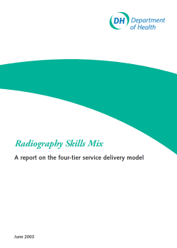

Career Progression Framework
Clinical practice
Consultant Practitioner
Advanced Practitioner
Practitioner [Registration level]
Assistant Practitioner
Notes:
2000 Allied Health Professions strategy meeting the challenge described a new level of practice “consultant therapist”
Early 2000s the CoR defined the 4 tier career progression model with support workforce and advanced and consultant practitioner roles
In 2003 DH funded work reported on the successful implementation of the 4 tiers across clinical imaging including breast screening and radiotherapy
Address the shortages through upskilling, increasing knowledge enabling better use of skills – professionals working to the top of their ability
Retention of the workforce and development of roles focused around patient pathways and innovation

Slide 8


Recognition of the national importance of
Advanced Clinical Practice across UK
Advanced Clinical Practice across the multi-professional workforce can be used:
to effectively enhance capacity and capability within teams
to provide safe, accessible and high quality care for patients
to help to close the gap of workforce shortages
to work differently in providing care delivery
Notes:
A new term encompassing advanced and consultant practice in the non medical workforce

Slide 9

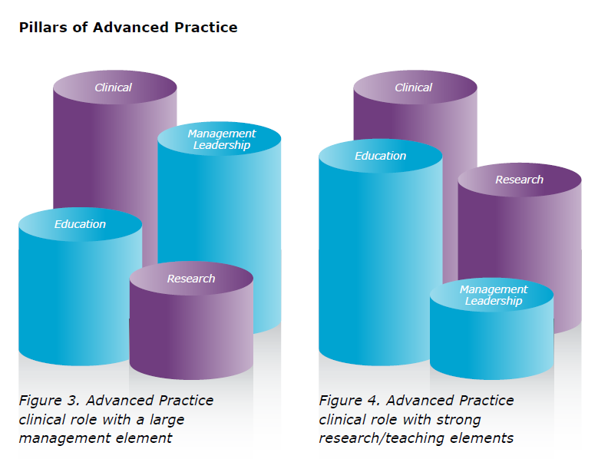
College of Radiographers Advanced Clinical Practice
Accreditation scheme
Are you an advanced clinical practitioner?
a learning programme including the 4 pillars
  Expert Clinical Practice
  Education and professional development.
  Professional leadership and consultancy;
  Practice and service development, research and evaluation;
https://hee.nhs.uk/our-work/developing-our-workforce/advanced-clinical-practice
Notes:
Four core domains
Diagrammatic representation very clear in the Framework for Advanced Nursing, Midwifery and AHP practice in Wales
Masters level education
Whilst all roles have clinical expertise as the prioirty there can be roles with large management / leadership elements and less focus on education and research, and other advanced practice roles with a greater focus alongside clinical expertise on research and education. The expectation is that there will be components of all the domains included within advanced practice roles.
For consultant roles the expectation is that all roles with have 50% component of clinical but will all the domains essential.

Slide 10

Research
...an essential part of radiographic practice
...an essential part of the radiographic career progression framework
All practitioners should be research aware;
Advanced practitioners should contribute to research and must use evidence in their practice;
Consultant practitioners should be advancing in practice and be leaders in their field, who are advising and supporting others. They will have a crucial function in ensuring research happens
The overarching Society and College of Radiographers’ vision for research is to improve patient care and outcomes by continuing to:
develop,
grow and
implement
a high quality evidence base that addresses key patient-focussed research

Slide 11
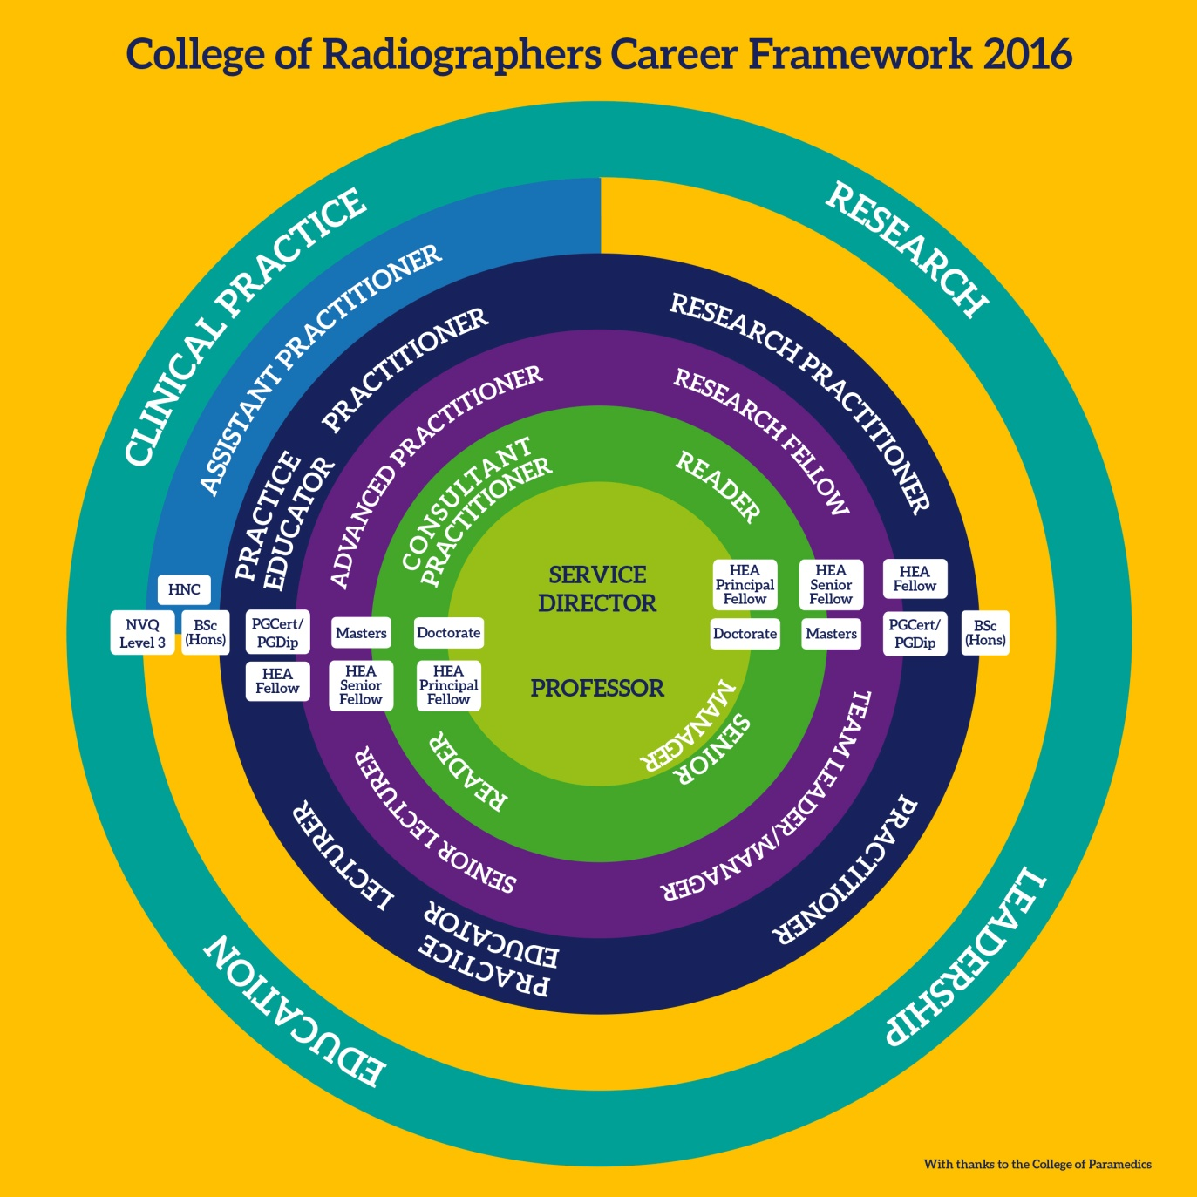
Career progression
Notes:
Underpinning education across the career framework – from NVQ Level 3 to Doctoral level studies across all areas of practice

Slide 12
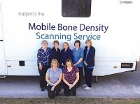
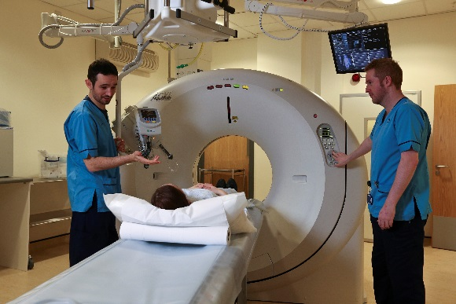
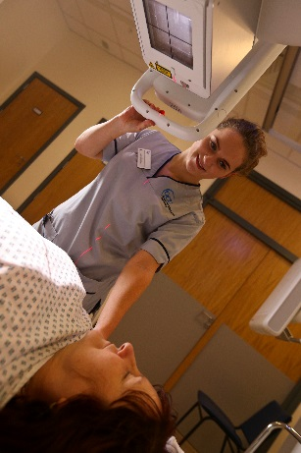
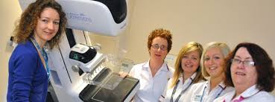
SCoR Scope of Practice definition
‘A member of the professional workforce can develop his or her own scope of practice as he or she determines, provided that he or she is adequately educated and trained and competent to practice’
https://www.sor.org/learning/document-library/scope-practice-2013/3-defining-individual-scope-practice

Slide 13

The Society of Radiographers
Expectations
By 2021 there must be an expectation that all practitioners in radiography at advanced practitioner level hold a minimum of a full Master’s degree.
By 2021 there must be an expectation that all practitioners in radiography at consultant level will hold, or be working towards, a Doctoral level award.
Research Strategy
SCoR 2016

Slide 14
Trend in workforce growth
Society of Radiographers, 2012-15
Notes:
We don't have the same census data for diagnostic radiography as for therapy and identifying true numbers is a challenge however % of workforce by career progression descriptor and relative numbers between surveys demonstrates growth and % contribution of each element.

Slide 15
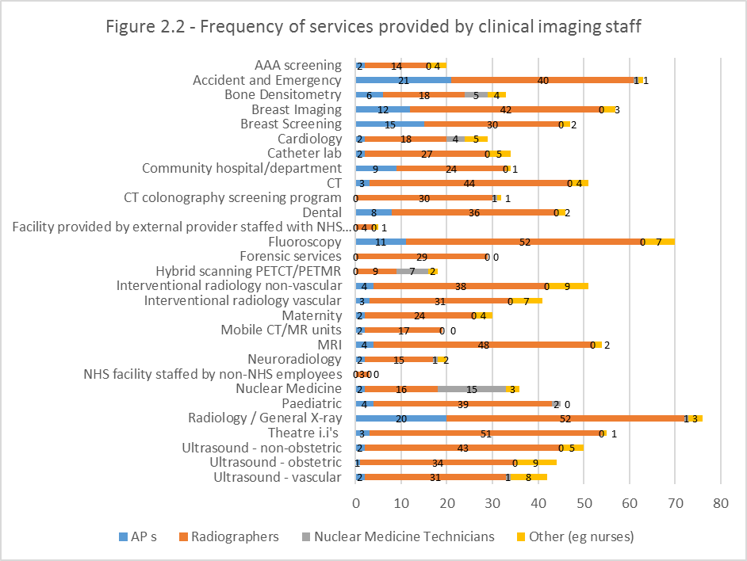

Slide 16
Examples of services where there are radiographer advanced practice roles
Notes:
Advanced practice is evident in a range of i radiography areas
Less than 50% of respondents indicated that they utilise advanced practice so room for growth is evident
It is not only reporting radiographers, significant numbers perform interventional procedures in breast and other areas.
There are 208 imaging departments in the UK (RCR, 2014).
71 managers in the UK responded to the SCoR Scope of Radiographic Practice Survey 2015.
In those 71 centres there are 835 advanced practitioners.
So, there could be 2446
diagnostic radiography AdPs in the UK.

Slide 17
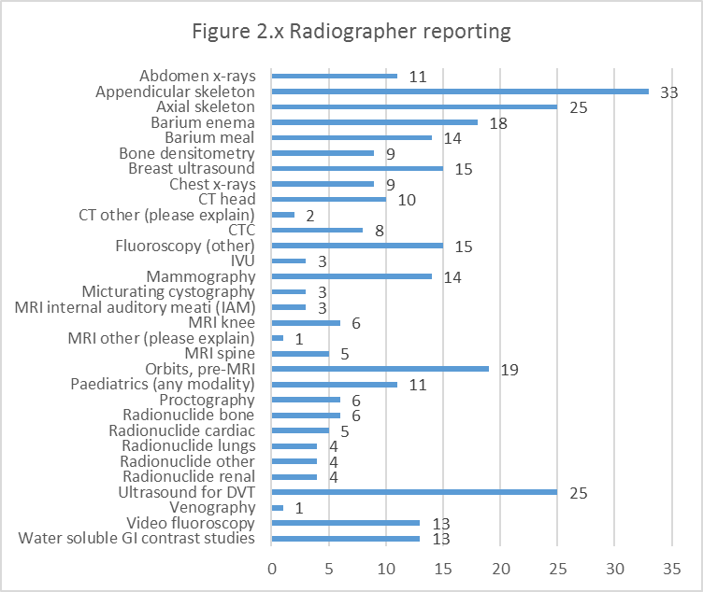
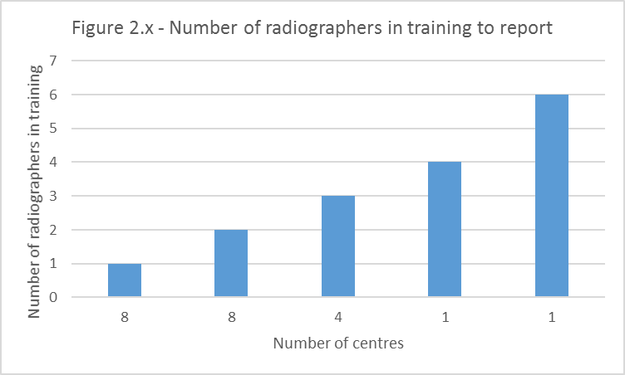
Scope of Practice 2015 advanced practitioners/reporting radiographers
Notes:
Radiographers report across a whole range of diagnostic imaging examinations
Some departments indicate that they have reporting radiographers in training = workforce challenge, back fill, cost of training etc
Where providers utilise reporting radiographers it is generally across multiple areas of practice
Some providers still do not utilise reporting radiographers

Slide 18
Scope of Practice 2015:
Consultant Radiographers
23% of responding providers employ consultant radiographers
30% of those with consultant practitioners have them in more than one area of practice
Notes:
The breadth of practice for consultant radiographers continues to develop

Slide 19
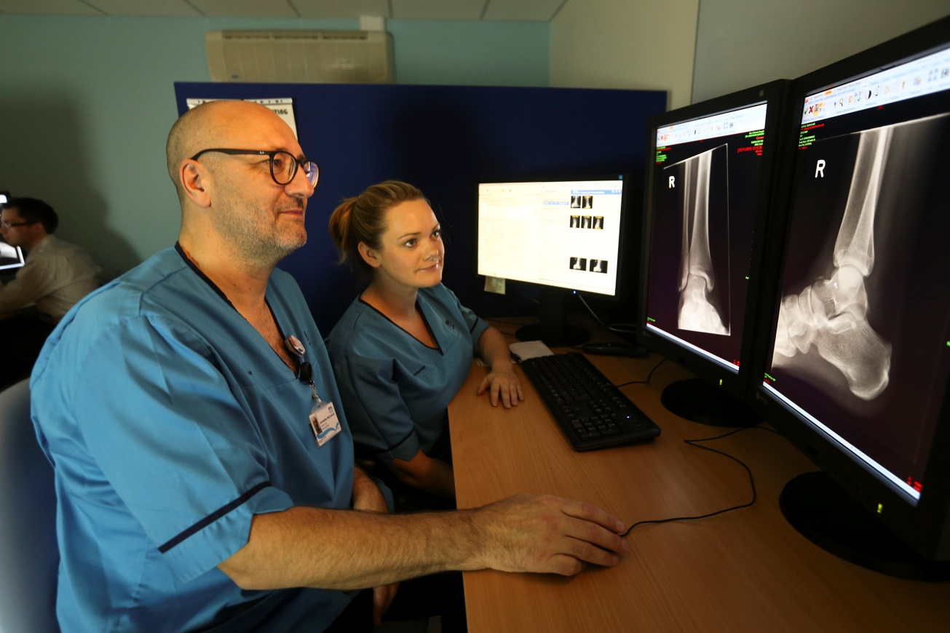
Notes:
Radiographers report across a whole range of diagnostic imaging examinations
Some departments indicate that they have reporting radiographers in training = workforce challenge, back fill, cost of training etc
Where providers utilise reporting radiographers it is generally across multiple areas of practice
Some providers still do not utilise reporting radiographers

Slide 20
SCoR Scope of Practice survey 2015
Diagnostic Radiography
  The Scope of Practice for diagnostic radiographers continues to expand; and with increasing numbers in advanced and consultant practice roles E.g. formal reporting of images, interventional procedures
  Significant increase in diagnostic radiographers involved in audit, clinical governance and quality management
  Assistant practitioners contribute to service provision for the around half of service providers
  Increase in providers with a radiographer with >0.2wte role in research (17% in 2012 and 29% in 2015)
Notes:
The SoP for diagnostic imaging is broad.
A list of more than 20 modalities/imaging areas was available for providers to indicate their service provision . The vast majority provide all services with significant numbers highlighting other areas of practice not on the list. E.g. Catheter laboratory services, Extra corporeal shock wave therapy/lithotripsy
Scope of Practice
Working to the top of your license
Advancing scope of practice: underpinning education, training and clinical competence
Innovating/ doing things differently
Reviewing pathways/skills mix: support workforce
Standards/Audit/Evaluation and Research

Slide 21
Key messages
Measure and promote the impact of change on patient experience/patient outcomes
Share good practice and evidence the quality
Implement best practice for patients :-use evidence, audit and research to influence change
Share service model examples, templates, toolkits to facilitate wider roll out
New workforce models - developed to meet patient needs not around professional boundaries
Much greater use of ALL skills
Across and between providers
Everyone working at their highest level, highest capability
Invest in the current workforce
PATIENT CENTRAL – across sectors
Notes:
Much greater use of ALL skills
Across and between providers
Everyone working at their highest level, highest capability
Invest in the current workforce
PATIENT CENTRAL – across sectors

Slide 22

Questions?

