Slide 1
Radiographer Reporting – A Happy Ending?
Professor Nigel Thomas
Consultant Radiologist

Slide 2
Radiographer Reporting – A Happy Ending
Professor Nigel Thomas
Consultant Radiologist

Slide 3
Outline
The past
The present
The future

Slide 4
The Past

Slide 5
Anon, B.M.J., 1903
“There is no reason for professional prejudices against the practice of radiology by lay men, so long as they confine themselves to the mere mechanical act of producing a picture, and abstain from assuming scientific knowledge of the bearing of their radiographs on diagnosis or prognosis”

Slide 6
J.H.E., B.M.J., 1917
“I would suggest that the practice of radiography by laymen be made a penal offence, and that laws be passed which will render it impossible for the practice of radiography to be carried out by other than skilled and trained medical experts”

Slide 7
F. Hernaman-Johnson, 1919
“To organize and educate the various classes of lay helpers”
“To see that their status, remuneration and prospects are such as to make them contented”
“To educate the public as to why such people are at one and the same invaluable as helpers, and extraordinarily dangerous when they seek to practice independently”

Slide 8
F. Hernaman-Johnson, 1919
“We should welcome lay assistance and seek to organize and guide it.”
“It is too late in the day to make a mystery of taking plates, but the interpretation is ours for ever”

Slide 9
Society of Radiographers, 1924
“The membership of the Society of Radiographers does not imply that the member is in possession of the necessary medical knowledge or training for the giving of diagnostic reports, and that the responsibility for the diagnosis must rest with the medical man in charge of the case”

Slide 10
C.W.Furby, Radiography, 1944
“The primary function of the radiographer is to be of the utmost service to the radiologist”
“The function of the radiologist is the interpretation of the radiograph”

Slide 11
Historical Perspective
Swinburne, Lancet 1971, suggested that the task of distinguishing between normal and abnormal films could be undertaken by radiographers in view of “the chronic shortage of radiologists, and the fact that radiographers seem to function below their full potential”

Slide 12
Historical Perspective
Saxton, Clinical Radiology 1992, reiterated the view that radiographers might report effectively on selected groups of examinations, provided that “they were given proper training and supervision”

Slide 13
Further Progress
Berman L, de Lacey G, Twomey E, Twomey B, Welch, T and Eban, R. ‘Reducing errors in the accident department: a simple method using radiographers’, British Medical Journal 1985; 290: 421-2
Loughran,C.F., Reporting of fracture radiographs by radiographers: the impact of a training programme. Br.J.Radiol.,1994
The Extended Role of the Radiographer Project (Leeds),1995 – trauma films, chest and abdomen

Slide 15
The Present

Slide 16
A few thoughts about the Present…
Reported images are not actually reported
The Gold Standard is not the Gold Standard
You’re part of the furniture now
Clinical Medicine is not dead, but it’s a bit off colour
Some people still don’t like us

Slide 17
The Future

Slide 18
The best preparation for tomorrow is to do today’s work superbly well
Sir William Osler (1849-1919)

Slide 19
Doing today’s work superbly well…
Audit and Governance
Support
Career Structure and working outside the NHS.

Slide 20
Audit

Slide 21
Audit
Resistance because “doctors don’t do it”
Who is the gold standard?

Slide 22
Audit
Audit is like a bicycle helmet

Slide 23
Audit
Audit is like a bicycle helmet
It doesn’t stop you having accidents, but , when you do, it can save your life

Slide 24
Audit
Audit is like a bicycle helmet
It doesn’t stop you having accidents, but , when you do, it can save your life
Some people choose to cycle without a safety helmet…

Slide 25
Audit
Audit is like a bicycle helmet
It doesn’t stop you having accidents, but , when you do, it can save your life
Some people choose to cycle without a safety helmet…
Audit might make you a better cyclist…

Slide 26
Discrepancy Meetings
Very useful as a learning process
Traditionally a “Doctors Only” approach
Still some resistance, but Radiographers need to become actively involved

Slide 27
Support

Slide 28
Support
Radiographic Colleagues
Radiologists
University Departments
Interest groups

Slide 29
Career Structure

Slide 30
Working outside the NHS

Slide 31
Working outside the NHS
Audit
Numbers (burn out) and accuracy rate
Indemnity (learn lessons from the NHS)
Inland Revenue – self employed status / sources of income

Slide 32
The Future as I see it…
An increasing number of increasingly experienced and knowledgeable reporting radiographers who will become the mainstay of plain film reporting in the NHS, who will have a major role to play in the reporting of other modalities, and, through the use of practical skills, will contribute to patient management.
What used to separate Radiologists and Radiographers was breadth of knowledge and skills, now it’s the depth of skills and knowledge – Radiologists in the 20th Century will be fully occupied with Intervention, complex ultrasound examinations, and increasingly demanding cross-sectional imaging (CT, MR, PET-CT/MR)
Reporting Radiographers and Radiologists will be complementary not competitive

Slide 33
A Happy Ending?
We should be proud of what has been achieved, but not complacent
We should also recognise that, despite the fact that some still oppose the process, and we have come a long way, we’ve not yet reached the end

Slide 34
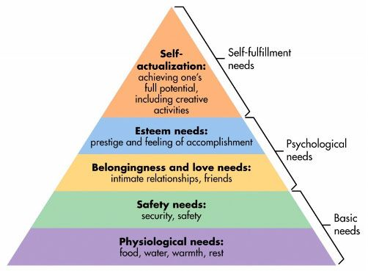
Maslow’s Hierarchy of Needs
“To see that their status, remuneration and prospects are such as to make them contented”

Slide 35
A Happy Ending...

Slide 36
A Happy Ending...To Be Continued…

