Slide 1
A Toolkit for Implementing Radiographer Chest Reporting
Alice Turner
Specialist Advisor for Radiography
Keele University
Previously Professional Lead Radiographer at UHNM

Slide 2
Introduction
Background
Where this already happening
Benefits
Understanding demand
Defining the existing capacity.
Quantifying the workforce
Governance
Building Capacity
Monitoring
Summary
CPD Outcomes

Slide 3
Background
February 2016 – 175,000 plain films unreported after 31 days (RCR)
CXR – first diagnostic test in Lung Cancer Pathway
Approx 20% lung cancer not detected on initial x-ray (in part due to lack of expertise)
15% vacancy rate for Consultant Radiologists
Increasing demand for cross sectional reporting and intervention
Is out-sourcing and extra contractual sessions sustainable?
Increasing evidence of the success of radiographers; performing as well as radiologists (in line with RCR and CoR joint position)
Notes:
RCR Diagnostic Radiology: Our patients are still waiting

Slide 4
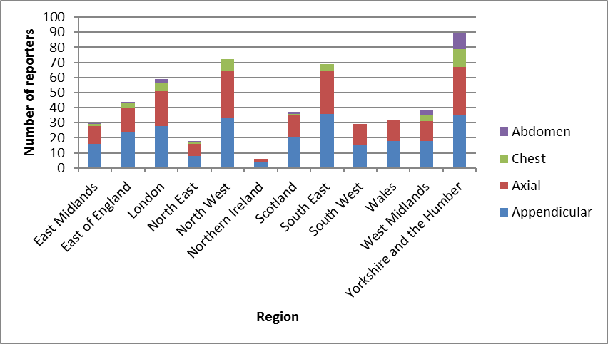
Anatomical areas reported by region.
Notes:
259 responses received, likely representing a quarter of UK total.
- 98.5 of respondents report appendicular skeleton
- 80.3% report axial
- 15.1% report CXR's
- 7.7% report AXR
Based on this Milner and Snaith estimate there are 100-150 CXR reporting radiographers in the UK
This was backed up by the survey undertaken by SCoR in 2015

Slide 5
Benefits
Improving Outcomes for Patients
Increase capacity
Increase quality
Contribute to education
Improve recruitment and retention
Provide an alternative to outsourcing

Slide 6
Understanding demand
Radiology Information System
Start with weekly demand
Aim to understand daily demand
Growth 2% (Benchmarking data)
Seasonal variation and Cancer Campaigns
Turn round times
Backlog – this is NOT your demand!
Meeting the demand…………………..

Slide 8
Defining the existing capacity.
Where do you start?
Job Plans?
Reporting patterns?
Turn round times
Not all reporters are equal!
Historical activity data
Beware of any Backlog Activity
Demand minus existing capacity =
The Gap.
Notes:
Job plans- are they defined enough to identify Plain film reporting sessions?
Reporting patterns – how many radiologists report just Chest? How many chests are reported as part of a multi-area attendance?
Turn-round times - Are you looking to do same day reporting? Shouldn’t you be?

Slide 9
Quantifying the workforce
Example:
Capacity gap per week 1400
Divide by number of reports predicted per session 70 = 20
Divide by no. of reporting sessions per rad/week 6.5 3.08
Add the percentage for AL/Sickness cover 22%
Number of reporting radiographers required. 3.75WTE
Notes:
Reports per session – RCR have tried to define a performance level but this is dependant upon many factors – including no interruptions!
Radiographers have no set standard and experience tells me the variation is significant.
Advanced Practitioner Radiographers deserve Job Plans – no one can report for 10 sessions per week and they have a requirement to fulfil the other pillars of advanced practice – education, research, leadership.

Slide 10
Simples!

Slide 11
Governance
Indemnity
Risk assessment and management
Quality Assurance
MDM
Discrepancy Meetings
Audit
Teamwork
CPD
Education and Training
Academic
Canterbury Christ Church University
Birmingham City University
University of Bradford
University of Salford
Cardiff University
Clinical
Don’t under estimate how much of this is needed.
Think about partnership working with other organisations.
Mentorship
Radiologists
Chest Reporting Radiographers
Notes:
Canterbury Christ Church University (South East)
Birmingham City University (Midlands)
University of Bradford (Yorkshire and North East)
University of Salford (North West)
Cardiff University (Wales)

Slide 12
Building Capacity: Developing a business case
Why?
Strategic Drivers.
Examination to report turnaround times
Risk Management
7 day working
Evidence base
What?
Data
Demand, Capacity and Gap
Support from the wider MDT
Governance and assurances
Resources required
Benefits?
Improving outcomes for patients
Avoiding litigation
Extending 7 day services
Accreditation - ISAS standards
Recruitment and retention of radiographers
Cost avoidance – out-sourcing, premium rate costs, 7 day/ extended day working to minimise investment in workstations etc.
Notes:
Resources required:
Number and grade of staff
Additional resources such as workstations and office space, training etc
Cost

Slide 13
Monitoring
Management of the reporting lists
Define the required turn-round time from acquisition to report
(this will influence your need for data reports)
Report in line
Beware of Carve Out and Cherry Pickers!
Demand and Capacity Review
Frequency – annual?
Plan ahead – demographics of the workforce
Audit
Build in this capacity
RCR recommends all departments aim to implement a systematic review of 5% of all reports by December 2018

Slide 14
The evidence is there, so…………….
What is stopping you?
Increasing numbers but in pockets around the country –why?
There are courses available but do we need more?
Should reporting radiographers be built into workforce plans?
Should we have a standard for radiographers to ensure they maintain competence and therefore quality?

Slide 15
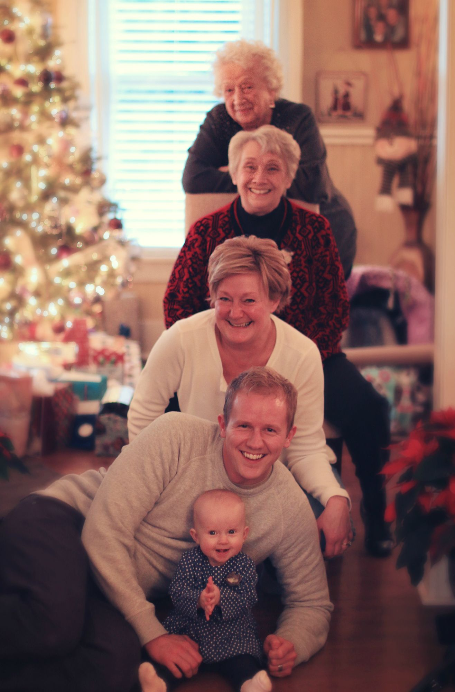
Final Question
Do our patients not deserve this?

Slide 16
CPD Outcomes
Practical Skills
Knowledge Base
Work Safely – Governance
High Quality Health Care Services
Leadership/Management Skills
12. Service Design
22. Further the Profession

